Slide 1

Customer Shopping Behavior Analysis
End-to-End Data Analytics Project
Python | SQL | Power BI

Slide 2
Project Overview
This comprehensive analysis examines customer shopping behavior to uncover key revenue drivers, demographic purchase patterns, product category performance, and subscription engagement trends.
01
Exploratory Data Analysis
Data cleaning and pattern discovery
By combining exploratory data analysis, structured query analysis, and interactive visualization, we transformed raw customer data into actionable business insights.
02
SQL Analysis
Advanced querying and aggregation
03
Dashboarding
Interactive visual storytelling

Slide 3



Project Pipeline
Our end-to-end workflow seamlessly integrates three powerful tools to transform raw data into meaningful insights.
Python EDA
SQL Analysis
Power BI
Data cleaning and exploratory analysis
Structured data querying
Visual dashboard creation
CTEs for modular queries
Interactive visualizations
Missing value detection
CASE statements for segmentation
No DAX required
Median imputation strategy
Stakeholder-ready reports
Distribution analysis
Multi-table joins

Slide 4
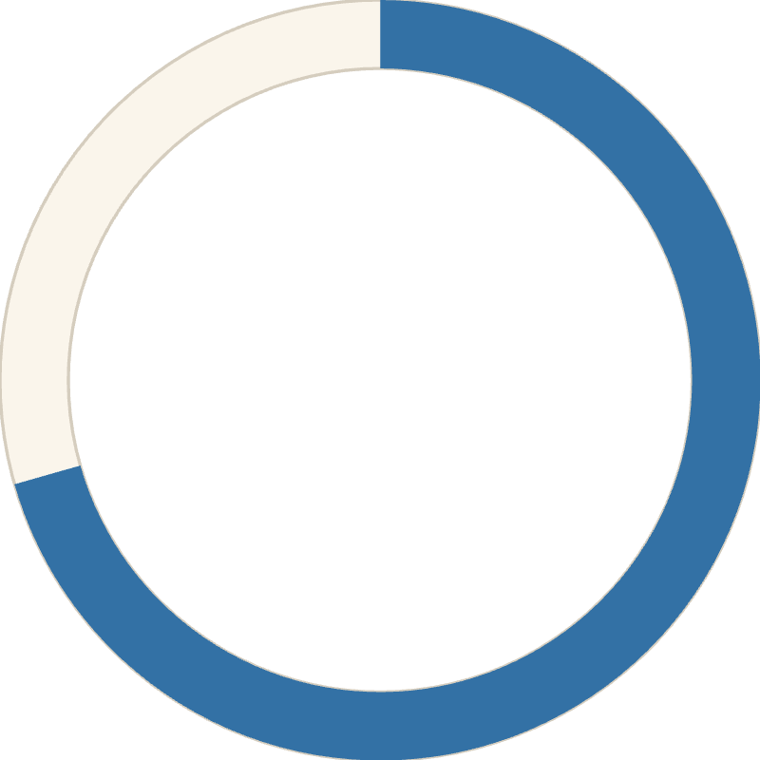
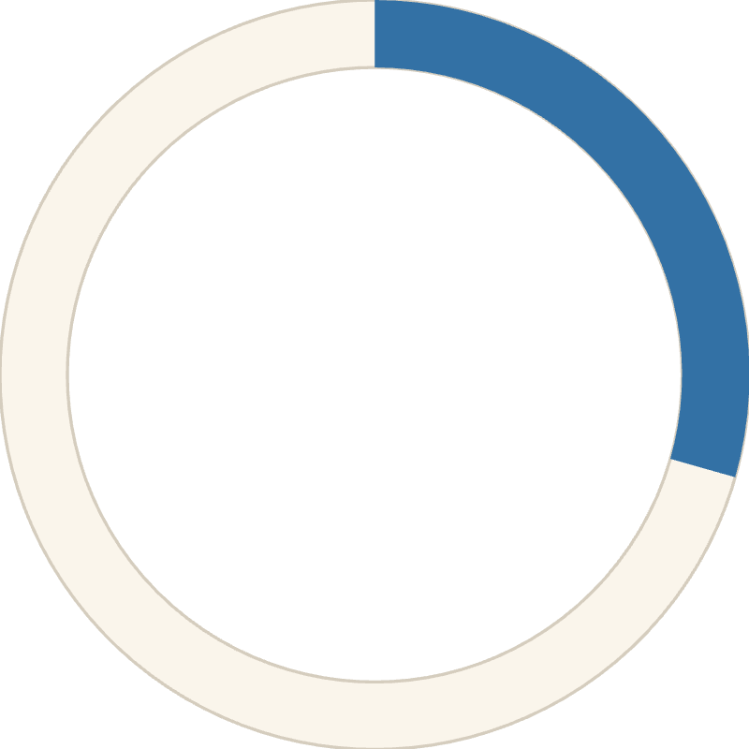
Dataset Overview
646
₹60.48
3.77
Total Customers
Avg Purchase
Avg Rating
Analyzed across all segments
Per transaction amount
Customer satisfaction score
70.59%
29.41%
Non-Subscribers
Subscribers
Majority customer base
Premium customer segment

Slide 5

Python: Exploratory Data Analysis
Data Cleaning Process
1
Missing Value Detection
Identified null values across all features to assess data completeness
2
Median Imputation
Applied robust statistical method to fill missing numerical values
3
Distribution Analysis
Examined data distributions to understand customer behavior patterns
4
Dataset Preparation
Exported clean, analysis-ready data for SQL processing

Slide 6




SQL Analysis Framework
Leveraged advanced SQL techniques to extract meaningful insights from cleaned data through structured, modular queries.
Common Table Expressions
CASE Statements
Built reusable query modules for complex analysis workflows and improved readability
Created custom segmentations including age groups, rating categories, and customer tiers
Category Aggregations
Revenue Calculations
Calculated revenue, sales volume, and performance metrics at the product category level
Computed total revenue, average order values, and profitability across customer segments

Slide 7
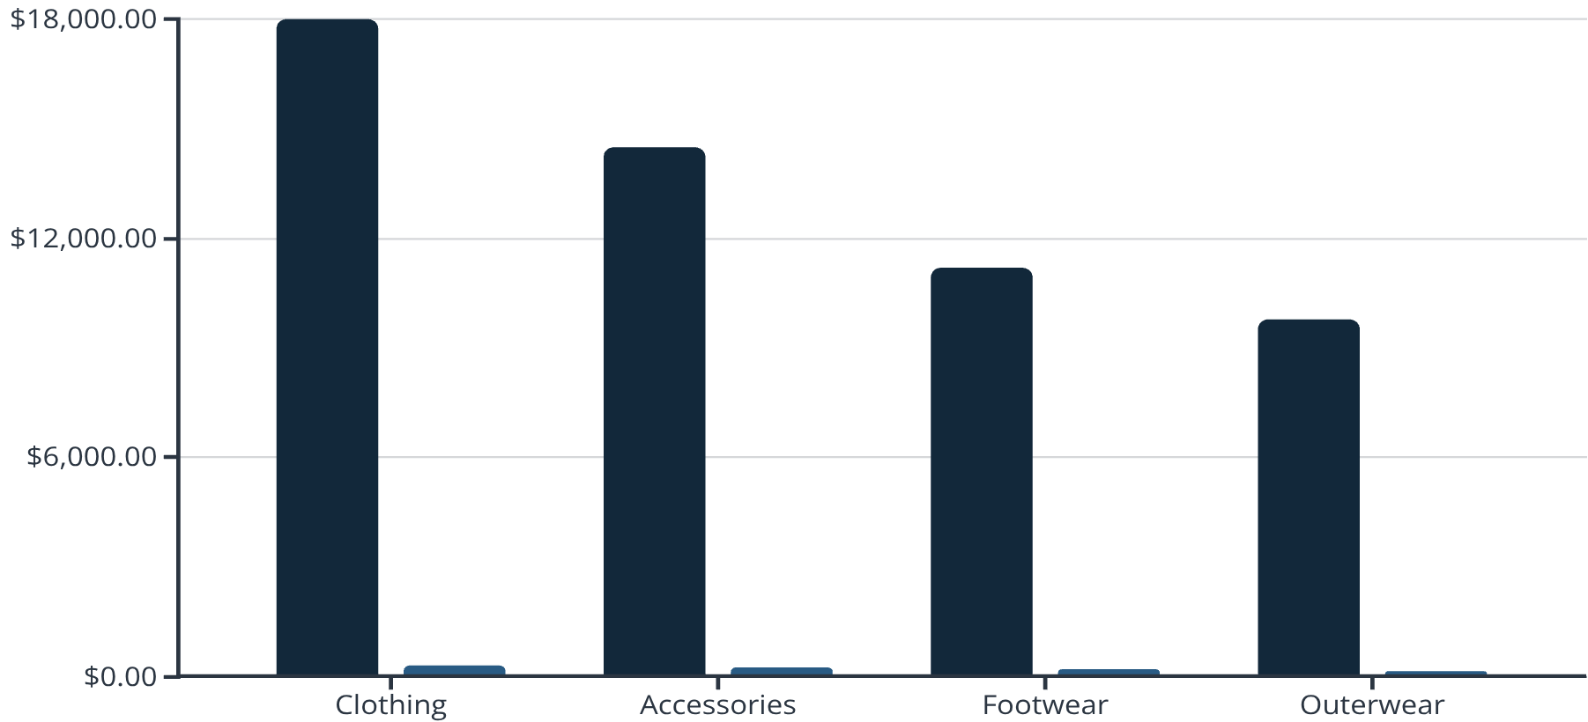
Category Performance Analysis
Key Findings
Clothing Dominates
Generated approximately ₹18K in revenue with 290+ individual sales transactions
Strong Accessories Market
Revenue
Sales Volume
Second-highest performer showing consistent customer demand

Slide 8


Age Group Insights
Seniors (60+)
Middle-Aged (40-59)
Young Adults (18-39)
Highest revenue contributors with premium product preferences and larger average transaction sizes
Strong revenue generators balancing purchase frequency with higher-value items
Highest purchase frequency but lower average spend per transaction, indicating price sensitivity
Strategic Opportunity: Young adults represent volume potential through targeted promotions, while seniors and middle-aged customers drive revenue through premium offerings.

Slide 9
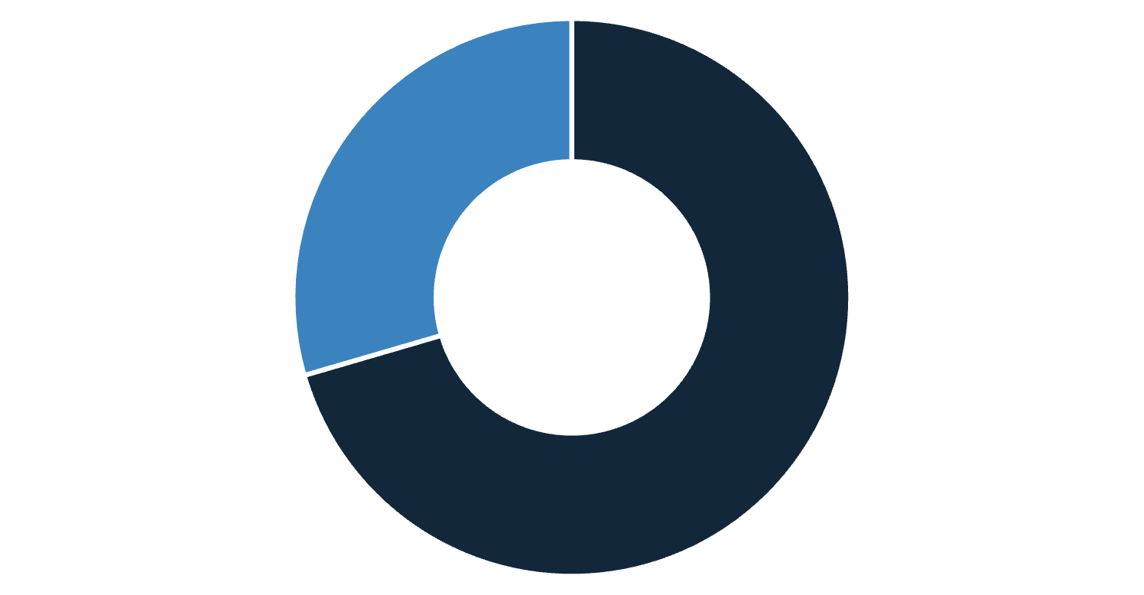
Subscription Model Performance
Subscription Insights
While the majority of customers remain non-subscribers, our analysis reveals that subscribers demonstrate significantly higher engagement levels.
Purchase Consistency
Subscribers show more regular shopping patterns with higher retention rates
Non-Subscribers
Subscribers
Lifetime Value
Subscription members contribute disproportionately higher customer lifetime value
Growth Opportunity
Converting even 10% of non-subscribers could significantly boost recurring revenue

Slide 10
Key Takeaways & Next Steps
Data Quality Matters
Clothing Leads Performance
Robust cleaning with median imputation ensured reliable analysis foundation
Focus inventory and marketing investments on top-performing categories
Age-Based Strategies
Subscription Growth
Tailor promotions differently for volume-driven youth vs. revenue-driving seniors
Develop incentives to convert non-subscribers and increase recurring revenue
This end-to-end project demonstrates the power of combining Python, SQL, and Power BI to transform raw data into actionable business intelligence.

